Slide 1

Java Scanner class
There are various ways to read input from the keyboard, the java.util.Scanner class is one of them.
The Java Scanner class breaks the input into tokens using a delimiter that is whitespace by default. The resulting tokens may then be converted into values of different types using the various next methods.
Scanner class provides many methods to read and parse various primitive values.
Java Scanner class is widely used to parse text for string and primitive types using regular expression.
Scanner
Keyboard
Java Application
Read
Read

Slide 2
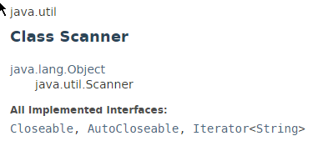
Java Scanner class

Slide 3
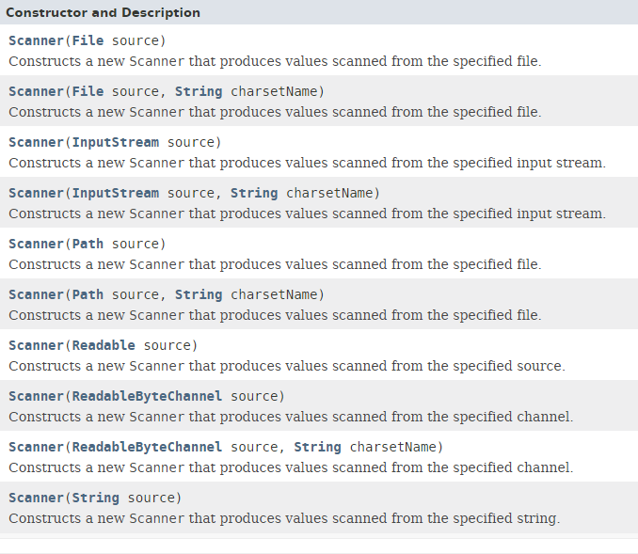
Java Scanner class

Slide 4
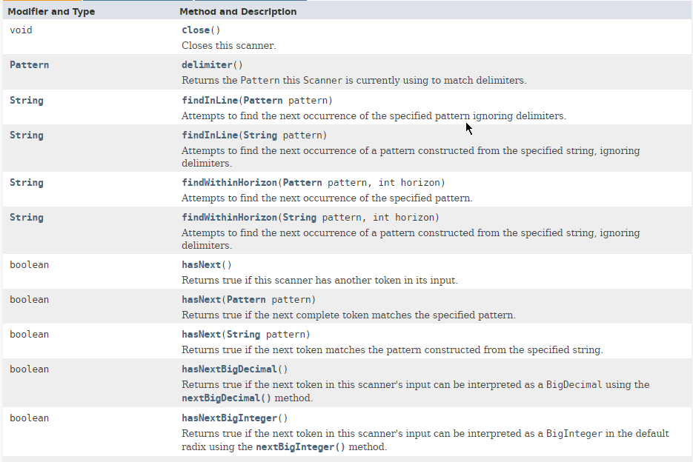
Java Scanner class

Slide 5
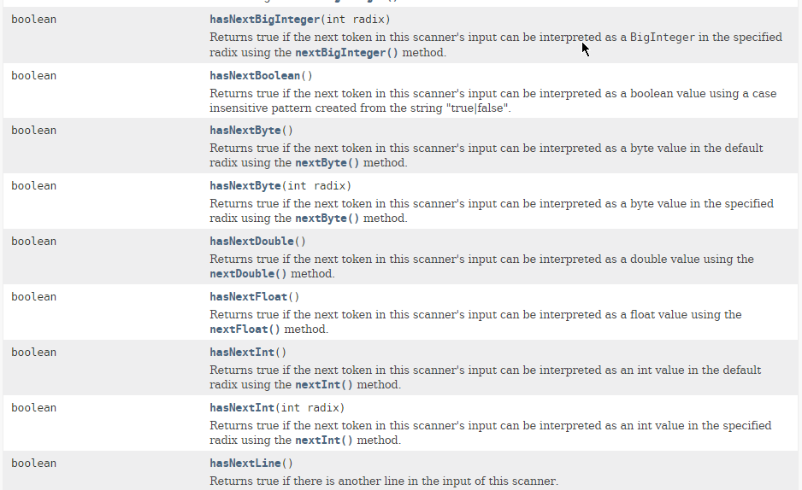
Java Scanner class

Slide 6
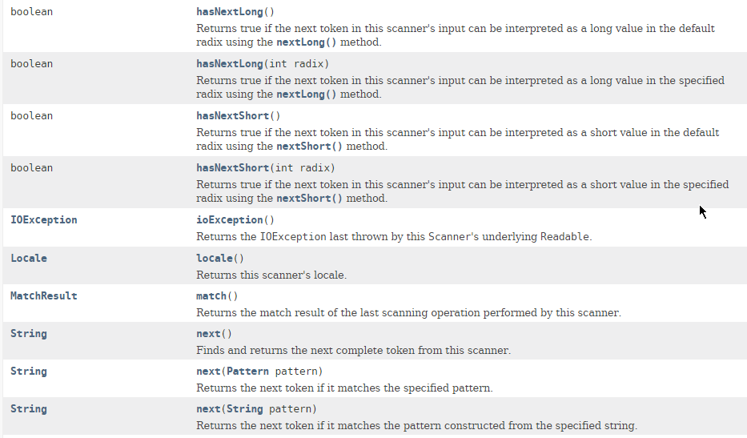
Java Scanner class

Slide 7
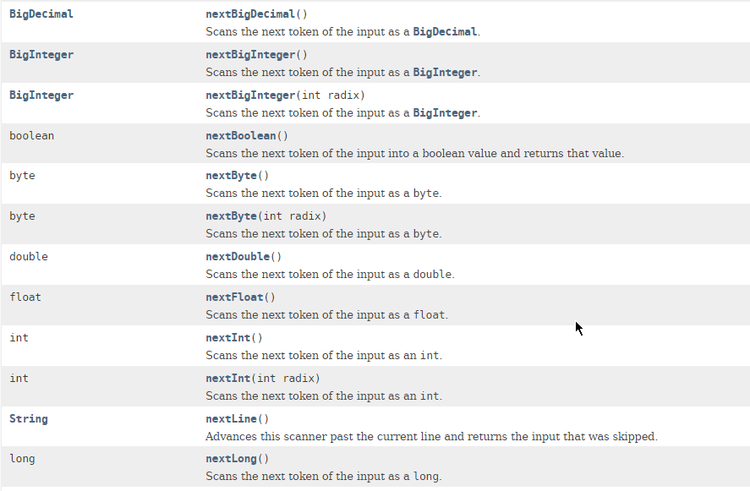
Java Scanner class

Slide 8
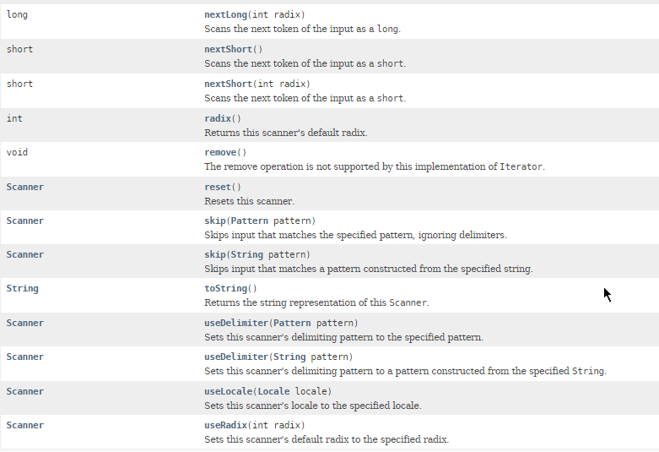
Java Scanner class

Slide 9
Java Scanner class
https://docs.oracle.com/javase/8/docs/api/index.html?java/util/Scanner.html

